Slide 1
UNSUPERVISED

Slide 2
Tasks
 | Output = continuous | Output = discrete
Supervised | Regression | Classification
Unsupervised | Dimensionality reduction | Clustering
Solutions
Hierarchical,
Non-linear Model
Deep NN
SVR/SVM,
NN
Non-linear Model
Linear Model

Slide 3
Tasks
 | Output = continuous | Output = discrete
Supervised | Regression | Classification
Unsupervised | Dimensionality reduction | Clustering
Solutions
Hierarchical,
Non-linear Model
Deep NN
Bayes, Logistic
SVR/SVM,
NN
Non-linear Model
kNN, NN,
Perceptron
Linear Regression
Linear Model
K-means
PCA

Slide 4
CLUSTERING: KMEANS

Slide 5
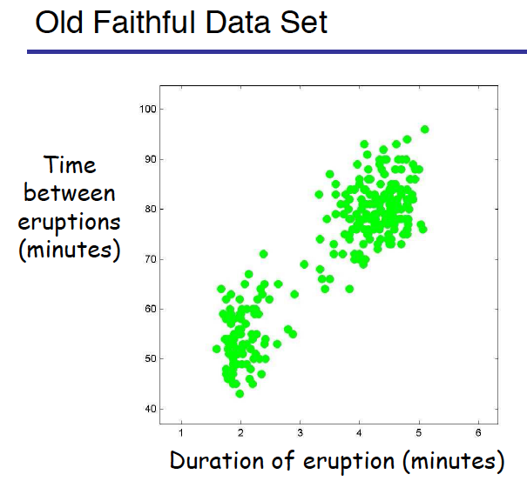
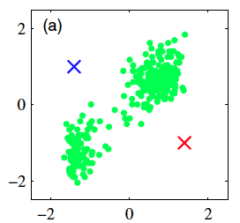
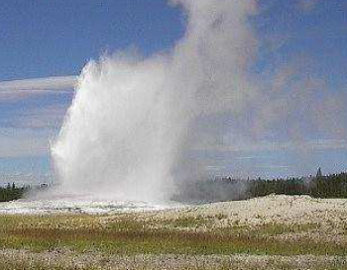
K means Clustering

Slide 6
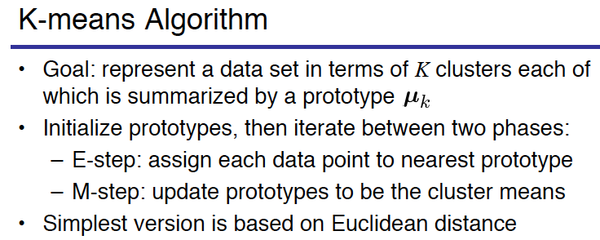
K means Clustering

Slide 7
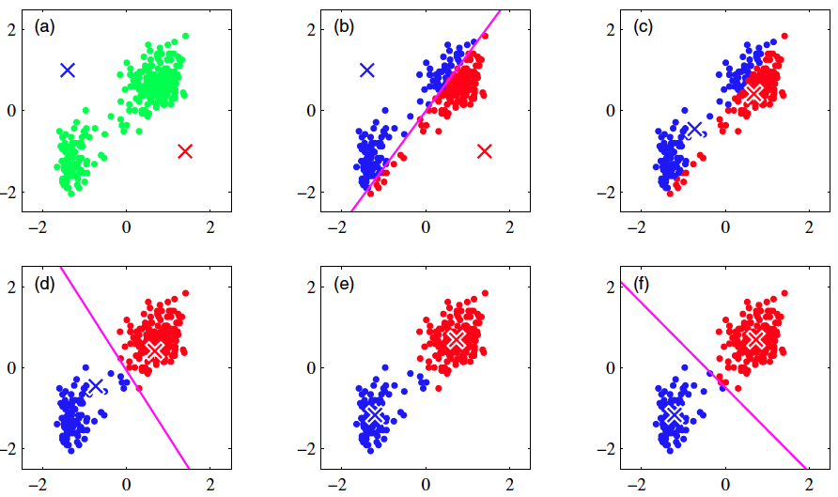
K means Clustering

Slide 8
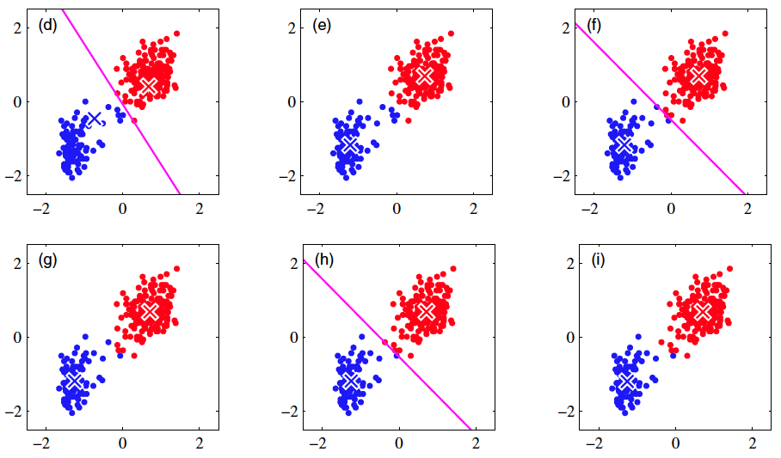
K means Clustering

Slide 9
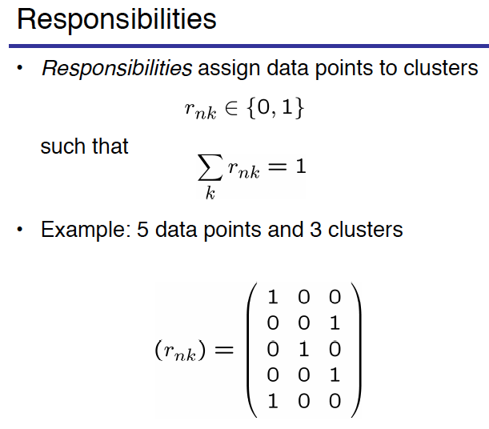
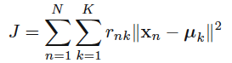
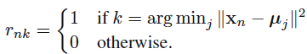
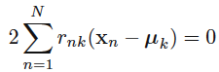
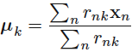
K means Clustering
Cluster centers
E Step
M Step

Slide 10
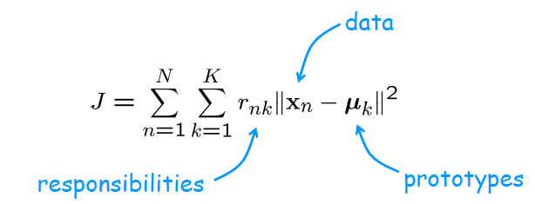
Distortion measure (cost function) of K means Clustering
https://towardsdatascience.com/k-means-clustering-algorithm-applications-evaluation-methods-and-drawbacks-aa03e644b48a

Slide 11
Assign step
Like Nearest
Neighbour but
Nearest cluster
Center
Update step

Slide 12
Assign step
Like Nearest
Neighbour but
Nearest cluster
Center
Update step

